Slide 1


Lecture 3: Pixels and Filters
Harbin Institute of Technology（Shenzhen）
Jingyong Su
sujingyong@hit.edu.cn

Slide 2
What we will learn today
Images as functions
Linear systems (filters)
Convolution and correlation

Slide 3


Images as functions
Images are usually digital(discrete):
- Sample the 2D space on a regular grid
Represented as a matrix of integer values
$$j$$
Pixel
62 | 79 | 23 | 119 | 120 | 105 | 4 | 0
10 | 10 | 9 | 62 | 12 | 78 | 34 | 0
10 | 58 | 197 | 46 | 46 | 0 | 0 | 48
176 | 135 | 5 | 188 | 191 | 68 | 0 | 49
2 | 1 | 1 | 29 | 26 | 37 | 0 | 77
0 | 89 | 144 | 147 | 187 | 102 | 62 | 208
255 | 252 | 0 | 166 | 123 | 62 | 0 | 31
166 | 63 | 127 | 17 | 1 | 0 | 99 | 30
$$i$$

Slide 4
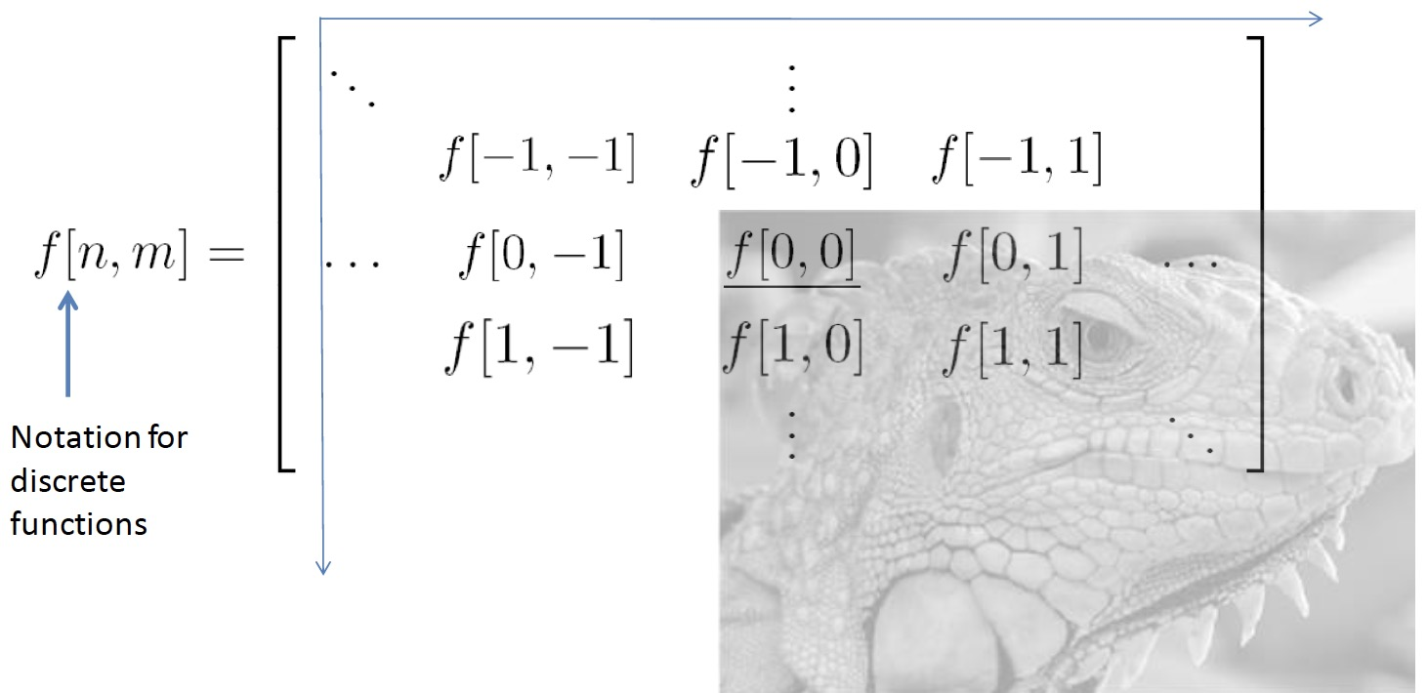
Images as functions
Cartesian coordinates

Slide 5
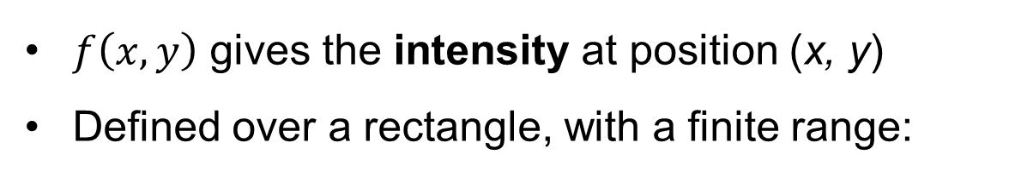
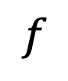
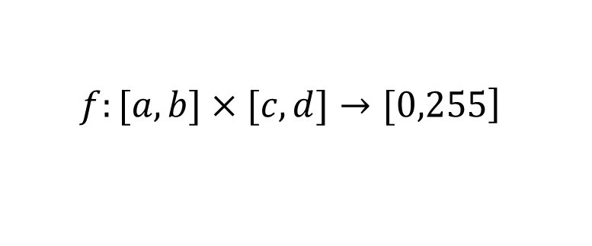
Images as functions
$$f$$
An image as a function from R² to R^{N}
$f\left(x, y\right)$ gives the intensity at position (x, y)
Defined over a rectangle, with a finite range:
$$\left.f:[a,b]×[c,d]→[0,255\right]$$
Domain Support
Range

Slide 6
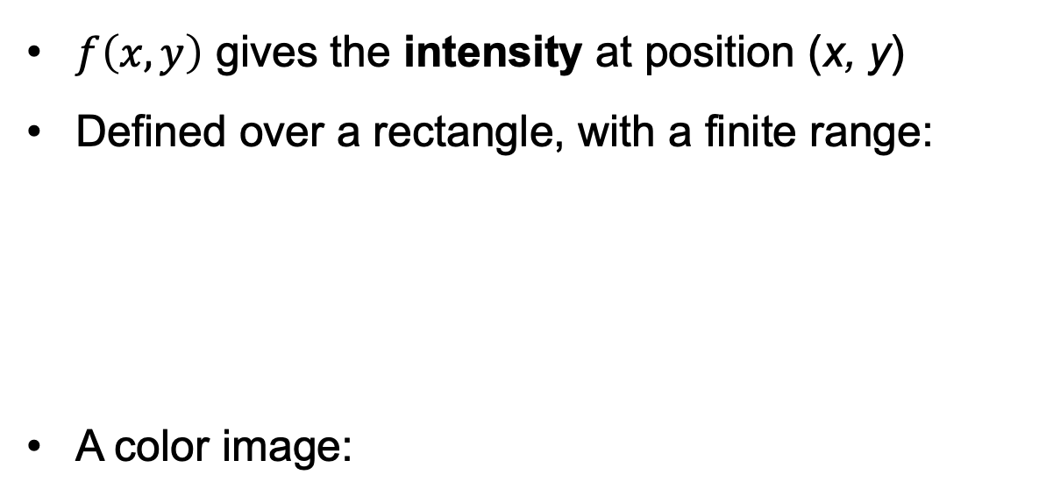
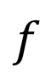
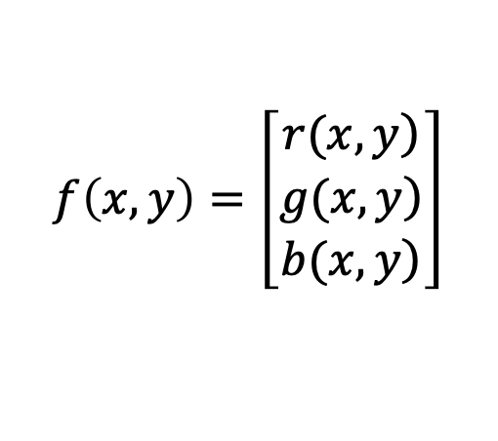
Images as functions
$$f$$
An image as a function from R² to R^{N}
$f\left(x, y\right)$ gives the intensity at position (x, y)
Defined over a rectangle, with a finite range:
A color image:
$$\left.f:[a,b]×[c,d]→[0,255\right]$$
Domain Support
Range
$$f\left(x, y\right)=\left[\begin{matrix}\left.r(x,y\right) \\ \left.g(x,y\right) \\ \left.b(x,y\right)\end{matrix}\right]$$

Slide 7
What we will learn today
Images as functions
Linear systems (filters)
Convolution and correlation

Slide 8
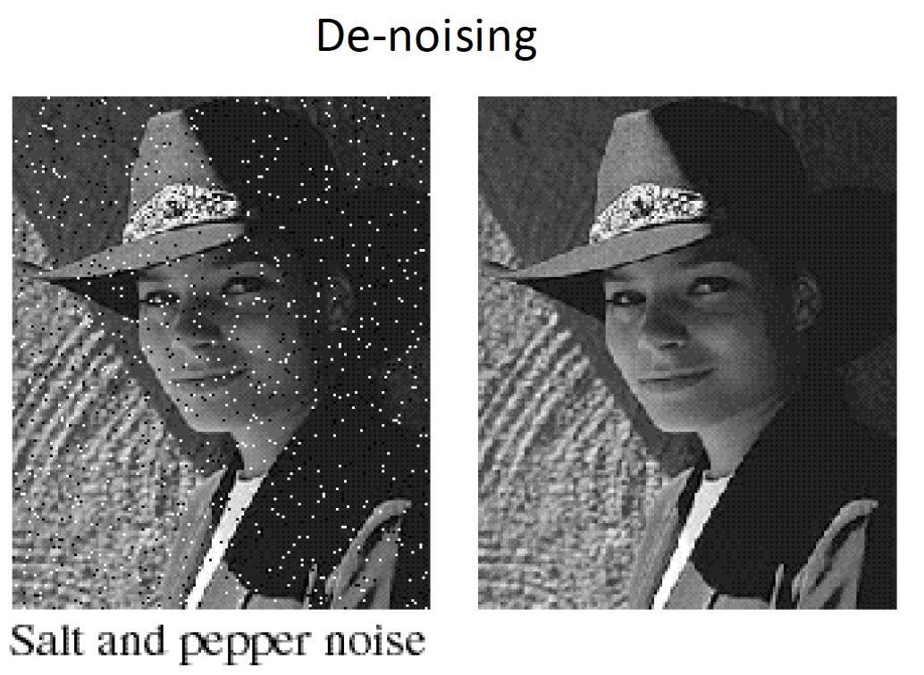
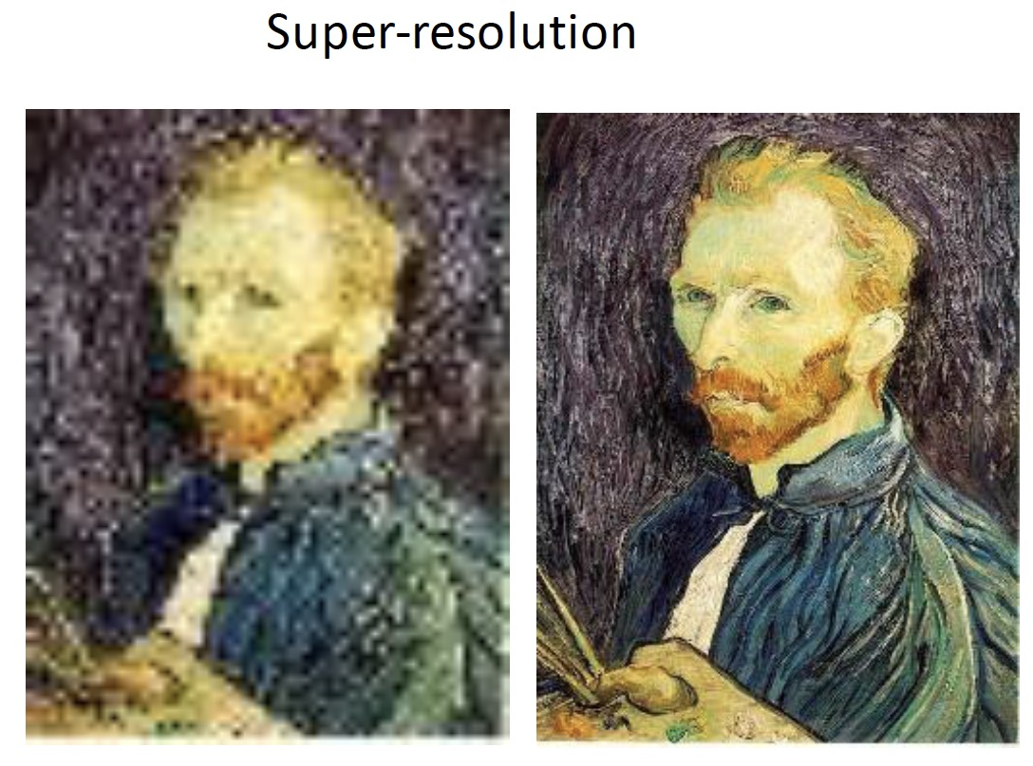
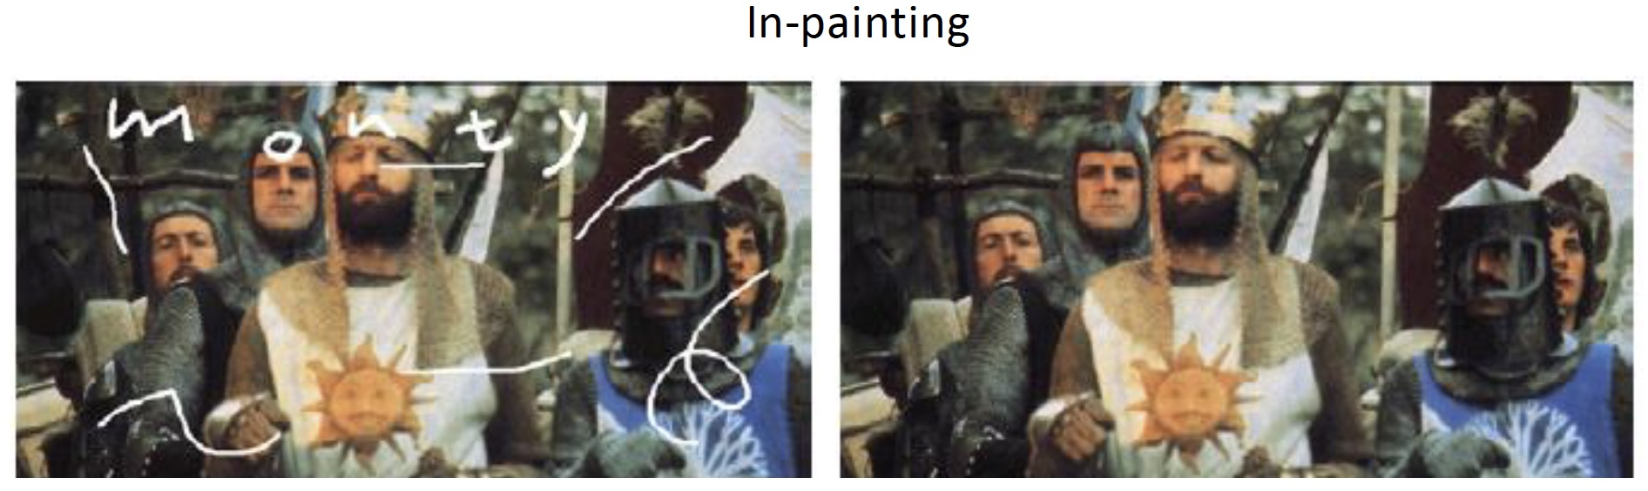
Applications of Linear Systems and Filters

Slide 9
Systems and Filters
Filtering:
Forming a new image whose pixel values are transformed from original pixel values
Goals:
Extract useful information from images
•Features (edges, corners, blobs…)
Modify or enhance image properties
•Super-resolution; in-painting; de-noising

Slide 10
Systems and Filters
S is the system operator, defined as a mapping/assignment that transforms the input f into the output g.

Slide 11
Filter example #1: Moving Average
2D moving average over a 3 × 3 neighborhood window

Slide 12
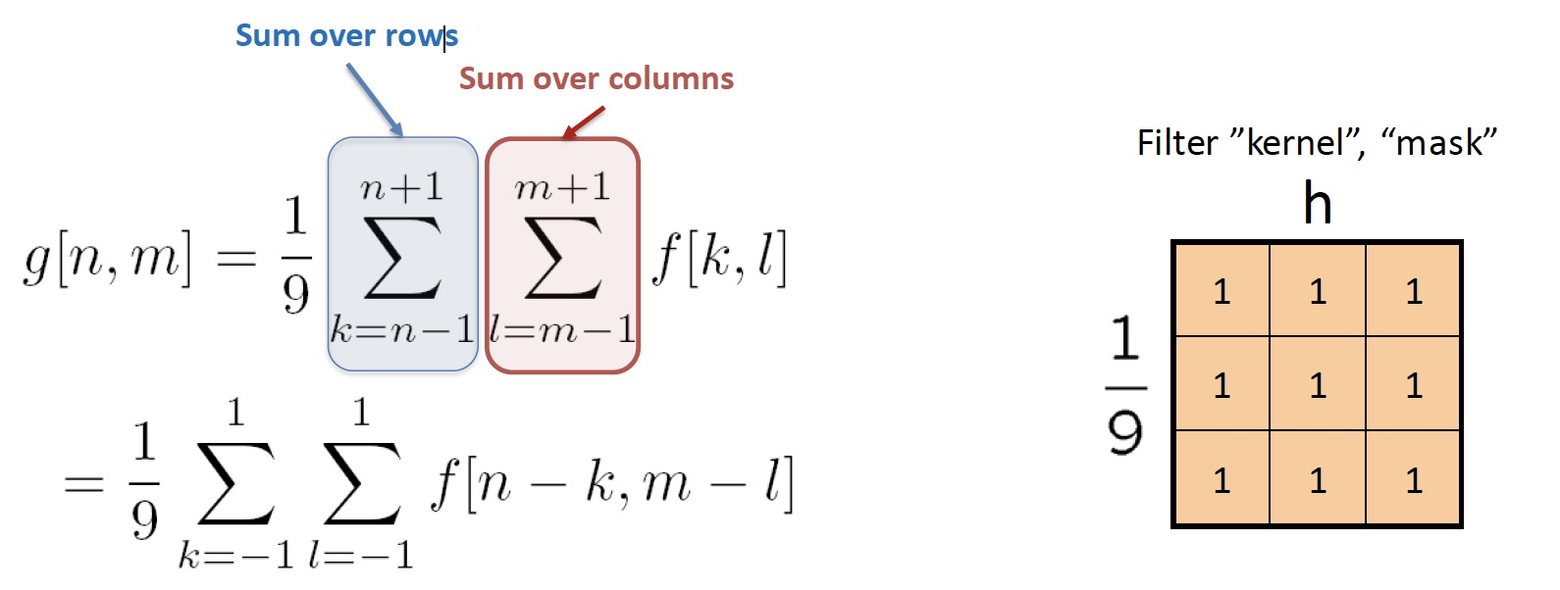
Filter example #1: Moving Average
2D moving average over a 3 × 3 neighborhood window

Slide 13
Filter example #1: Moving Average
In summary:
• This filter “transforms” each pixel value into the average value of its neighborhood
• Achieve smoothing effect (remove sharp)

Slide 14
Filter example #2: Image Segmentation
Image segmentation based on a simple threshold:

Slide 15
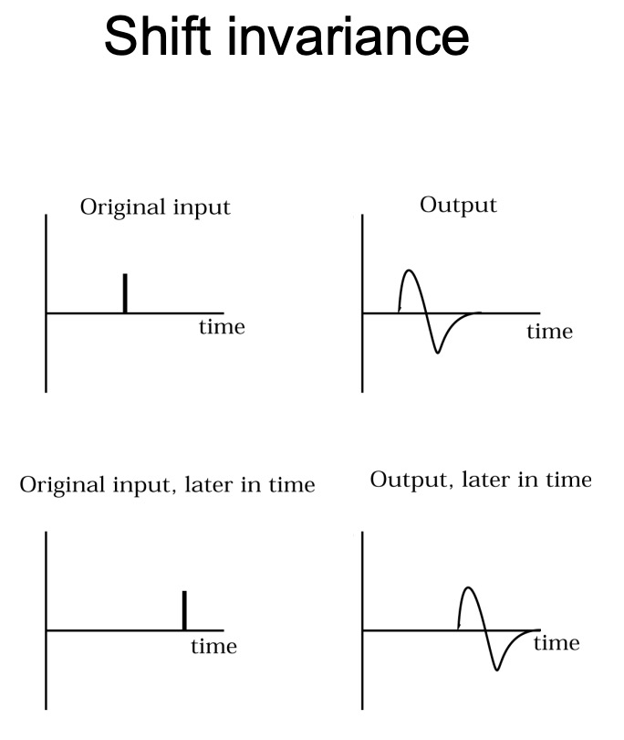
Systems can be classified based on their properties
Amplitude properties
•Linearity
•Stability
•Invertibility
Spatial properties
•Causality
•Separability
•Memory
•Shift invariance
•Rotation invariance

Slide 16
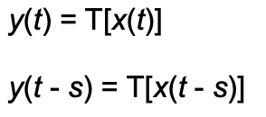
Linear Shift Invariant (LSI) systems
Linearity
Shift invariance
For a system to be shift-invariant (or time-invariant) means that a time-shifted version of the input yields a time-shifted version of the output:
The response y(t - s) is identical to the response y(t), except that it is shifted in time.

Slide 17
Linear Shift Invariant (LSI) systems
• An LSI system is completely specified by its impulse response h.
• By passing an impulse function into an LSI system, we get its impulse response.

Slide 18
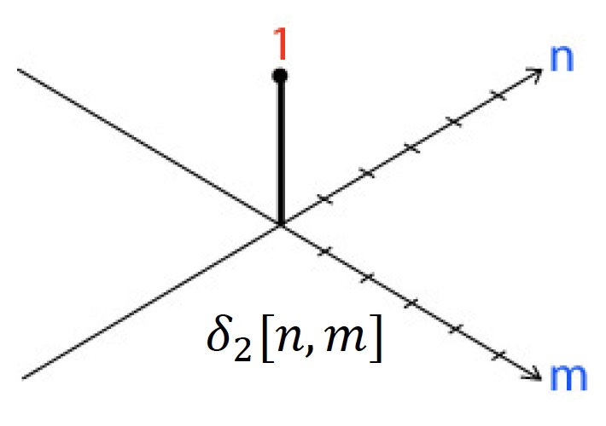
2D Impulse Function
• 1 at [0,0]
• 0 everywhere else

Slide 19
Impulse response to the moving average filter
•Recall the expression for our 3x3 moving average filter:
•We can use it to obtain an expression for the impulse response

Slide 20
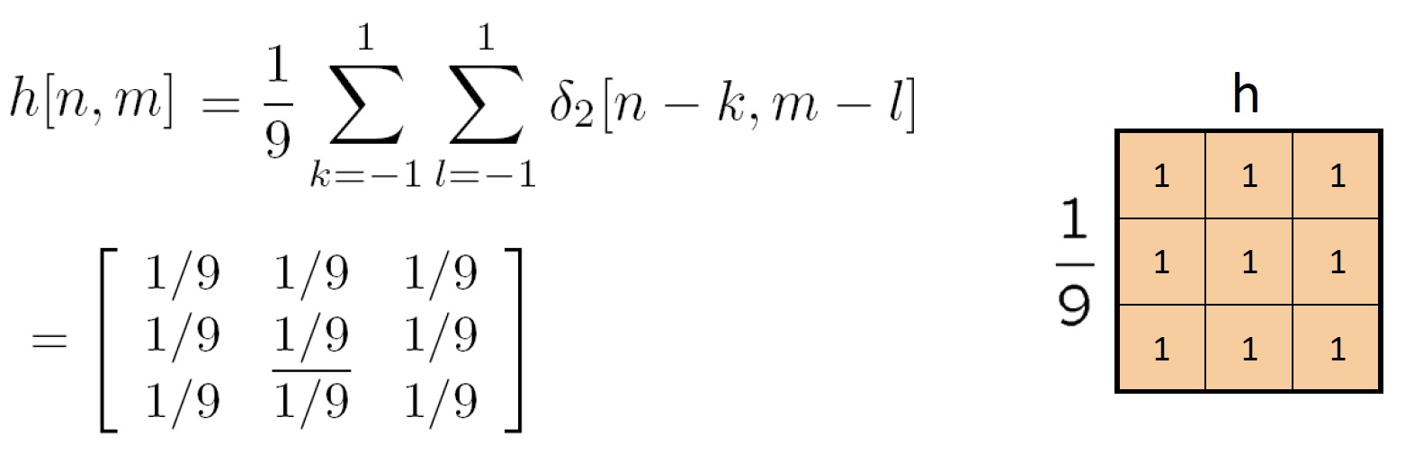
Impulse response of the 3 x 3 moving average filter

Slide 21
Linear Shift Invariant (LSI) systems
• An LSI system is completely specified by its impulse response h.
– For any input f , we can compute the output g in terms of the impulse response h.
– In the following, we’ll derive an expression for g in terms of h.
– We know the LSI system satisfies the linearity property and the shift invariance property. We also know h:

Slide 22
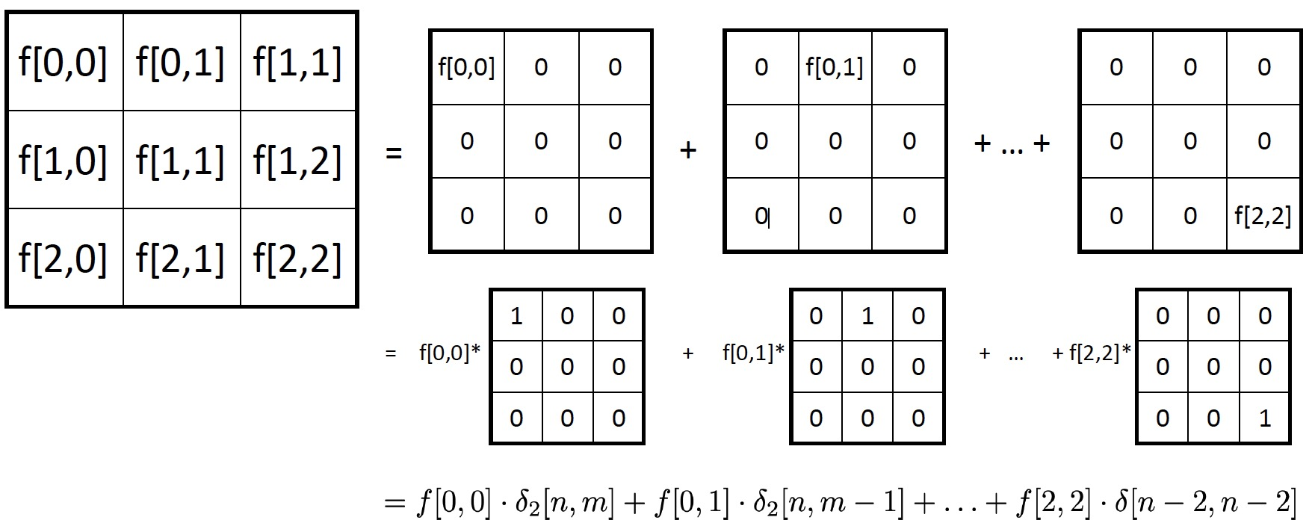
Key idea: write down f as a sum of impulses
Let’s say our input is a 3 x 3 image:

Slide 23
Key idea: write down f as a sum of impulses
• More generally:
•We can now use linearity to see what the output is:

Slide 24
Key idea: write down f as a sum of impulses
• We have
• Recall, by the shift invariance property that:

Slide 25
Key idea: write down f as a sum of impulses
• We have
• Which means,

Slide 26
Linear Shift Invariant (LSI) systems
• An LSI system is completely specified by its impulse response h.
– For any input f , we can compute the output g in terms of the impulse response h.
Discrete convolution

Slide 27
What we will learn today
Images as functions
Linear systems (filters)
Convolution and correlation

Slide 28
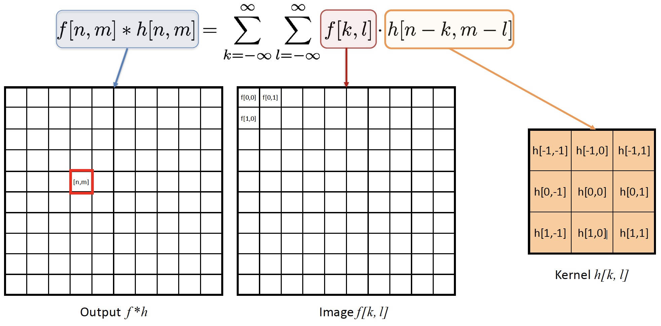
2D Discrete Convolution

Slide 29
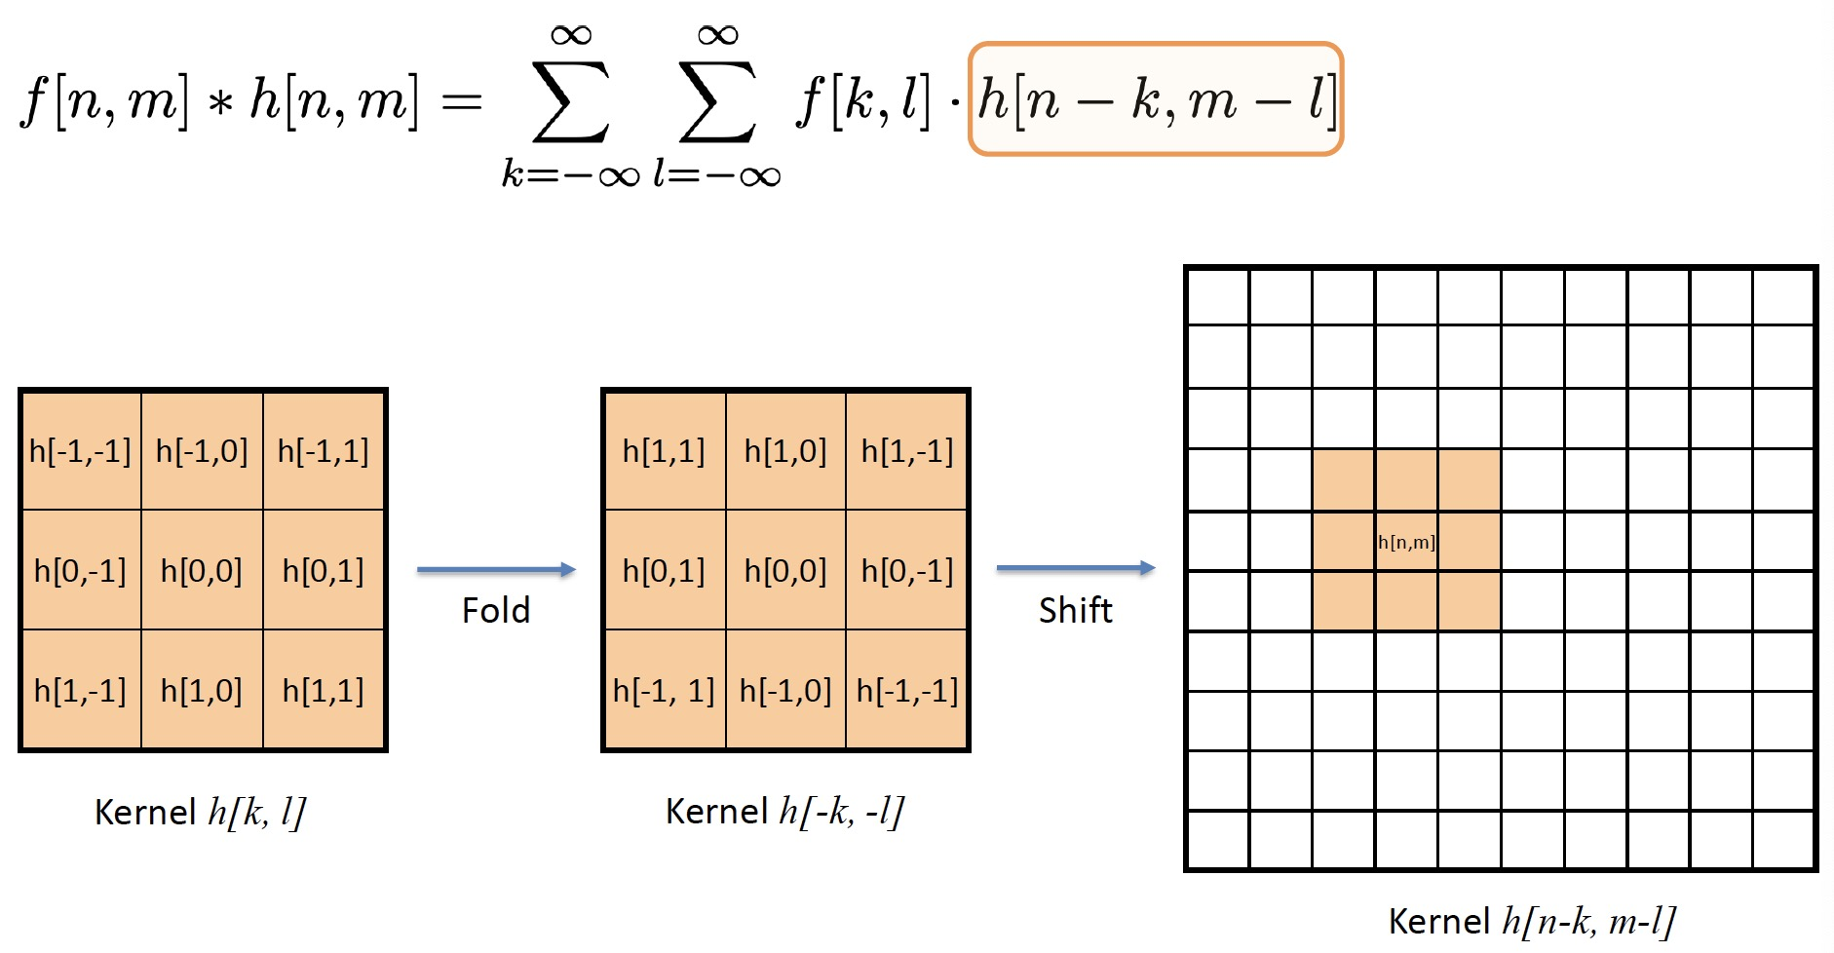
2D Discrete Convolution

Slide 30
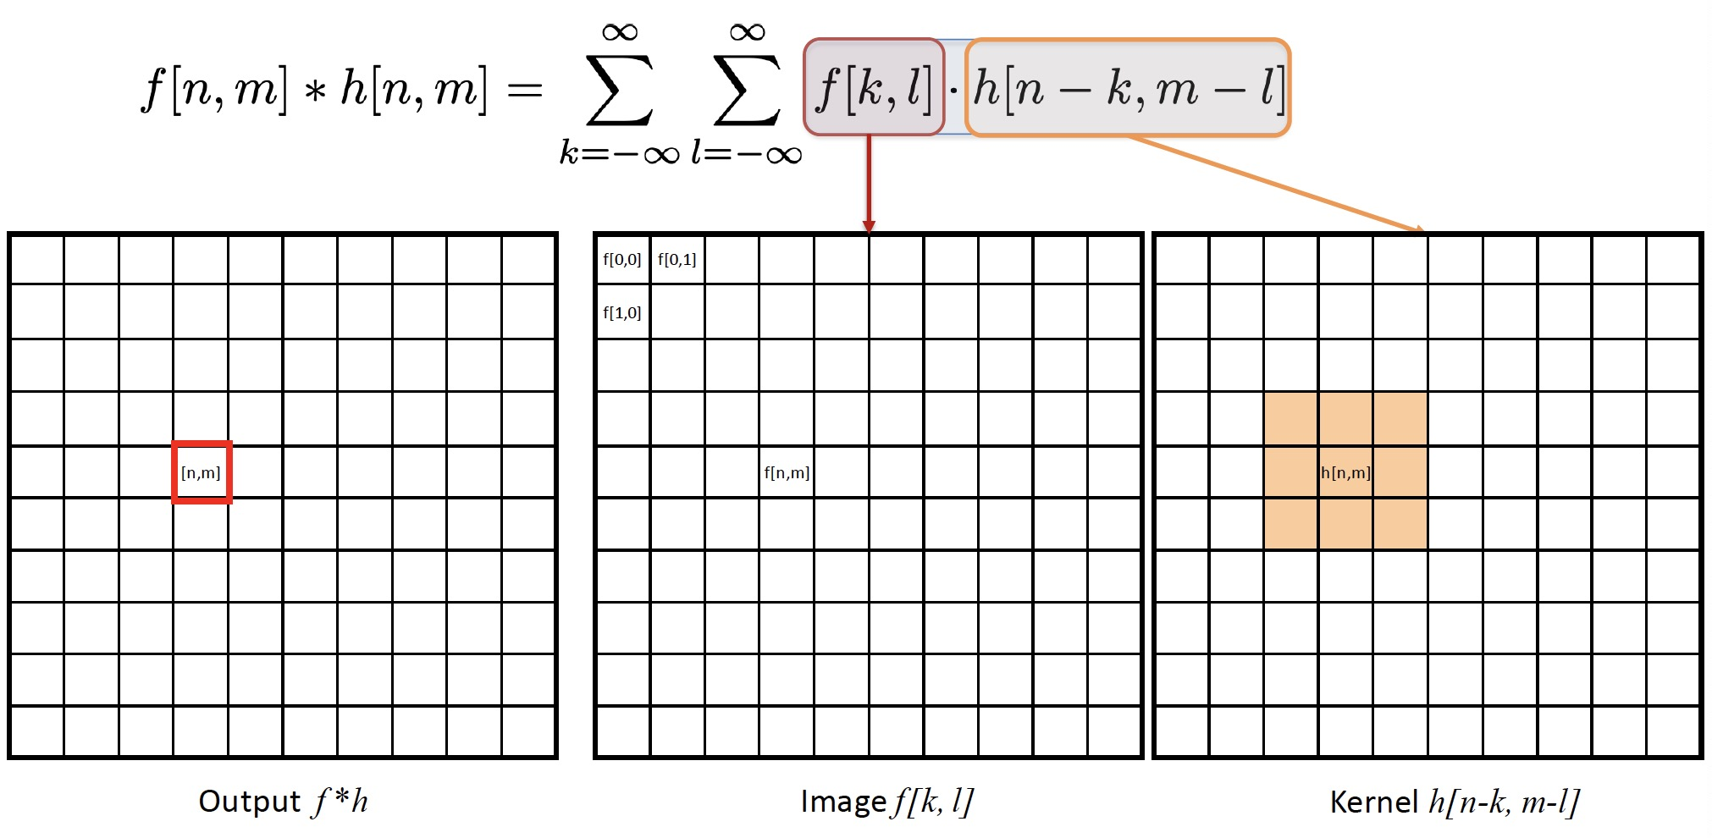
2D Discrete Convolution

Slide 31
2D Discrete Convolution
Algorithm:
•Fold h[k, l] about origin to form h[−k, −l]
•Shift the folded results by n, m to form h[n − k, m − l]​
•Multiply h[n − k, m − l] by f[k, l]​
•Sum over all k, l​
•Repeat for every n, m

Slide 32
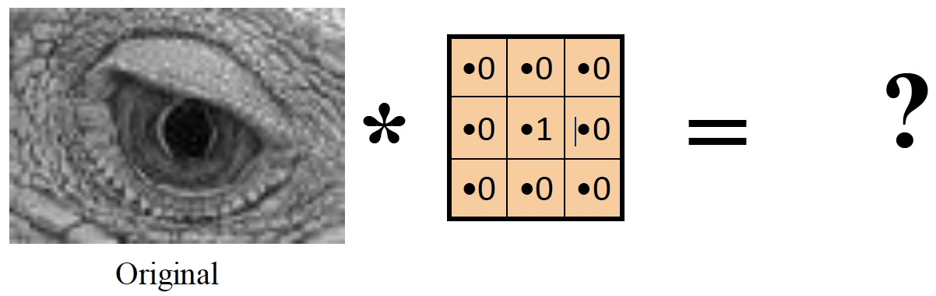
Convolution in 2D -- examples

Slide 33
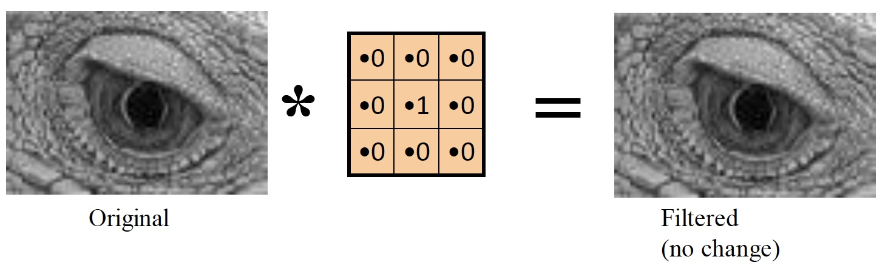
Convolution in 2D -- examples

Slide 34
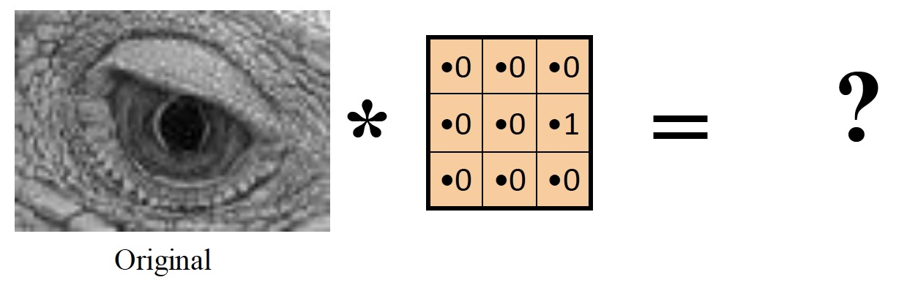
Convolution in 2D -- examples

Slide 35
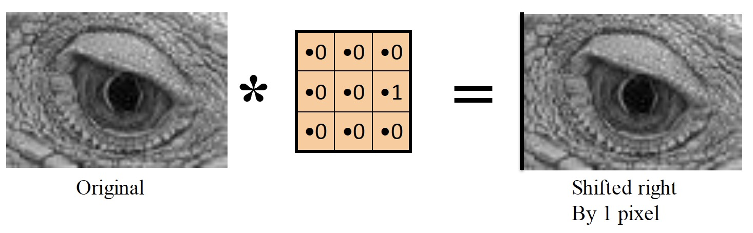
Convolution in 2D -- examples

Slide 36
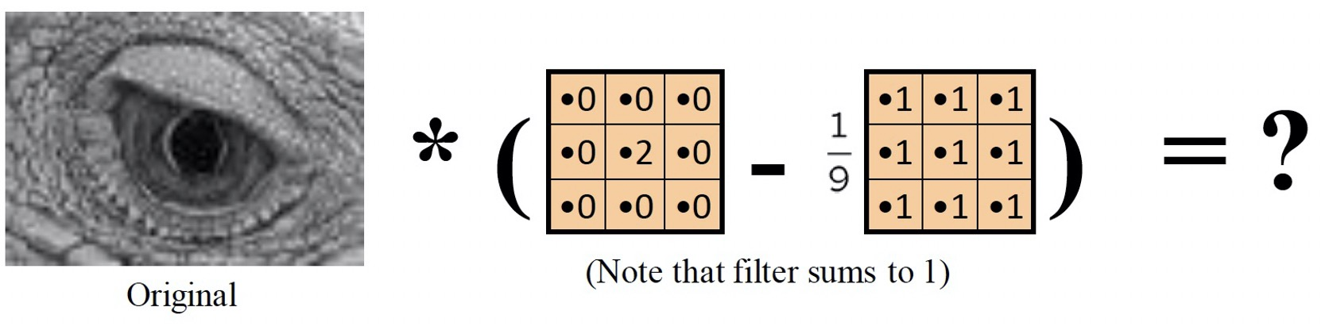
Convolution in 2D -- examples

Slide 37
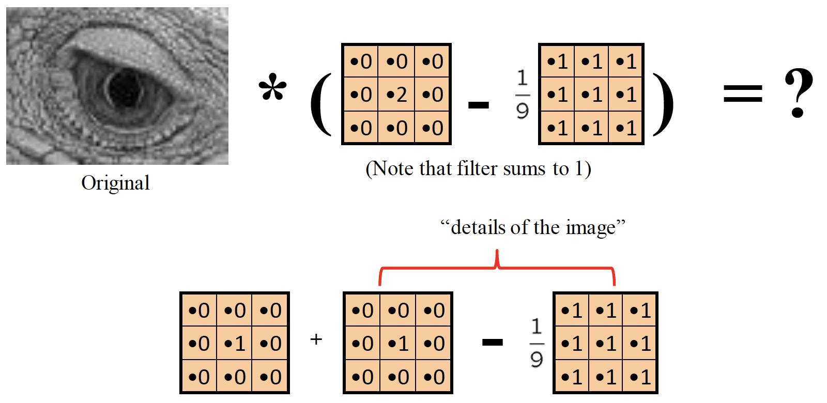
Convolution in 2D -- examples

Slide 38
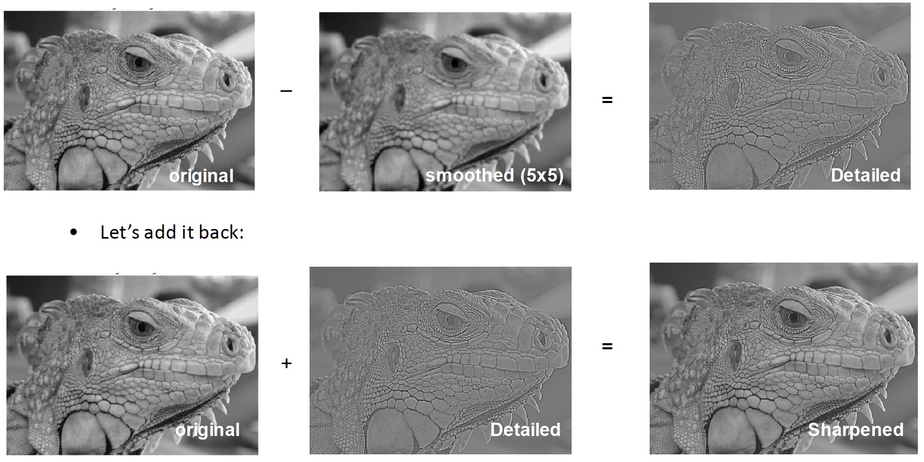
What does blurring take away?

Slide 39
What we will learn today
Images as functions
Linear systems (filters)
Convolution and correlation

Slide 40
(Cross) Correlation – symbol: **
Cross correlation of two 2D signals f[n,m] and h[n,m]
•Equivalent to a convolution without the flip
•Use it to measure ‘similarity’ between f and h

Slide 41
Convolution vs (Cross) Correlation

Slide 42
Convolution vs (Cross) Correlation
Convolution is an integral that expresses the amount of overlap of one function as it is shifted over another function.
–convolution is a filtering operation
Correlation compares the similarity of two sets of data. Correlation computes a measure of similarity of two input signals as they are shifted by one another. The correlation result reaches a maximum at the time when the two signals match best.
–correlation is a measure of relatedness of two signals

Slide 43
What we have learned today
Images as functions
Linear systems (filters)
Convolution and correlation

